Slide 1


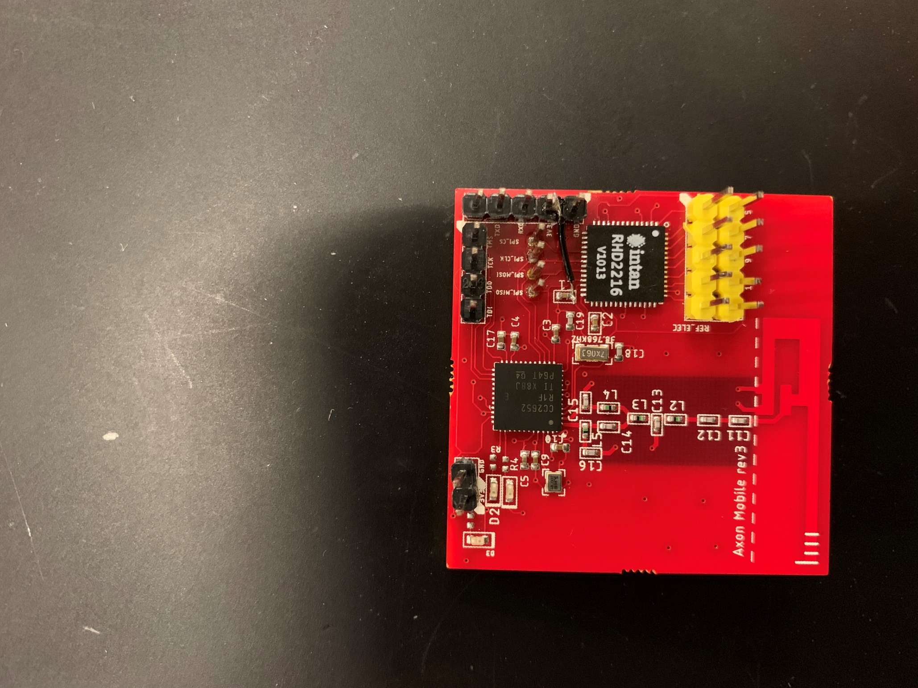

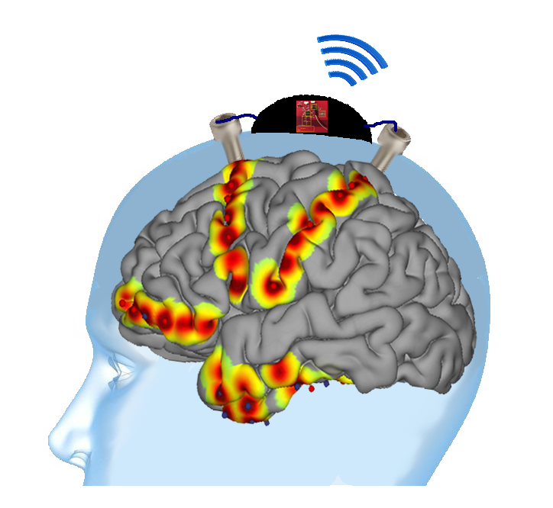

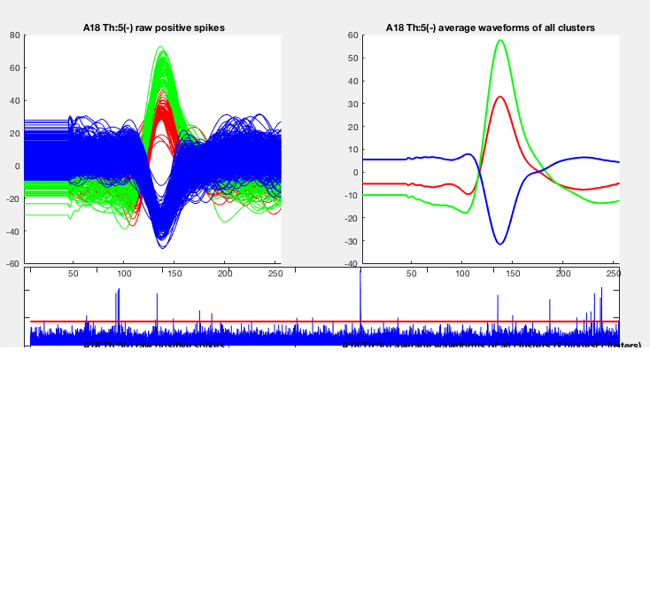
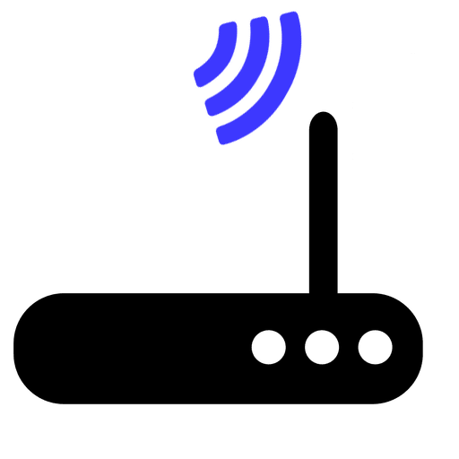
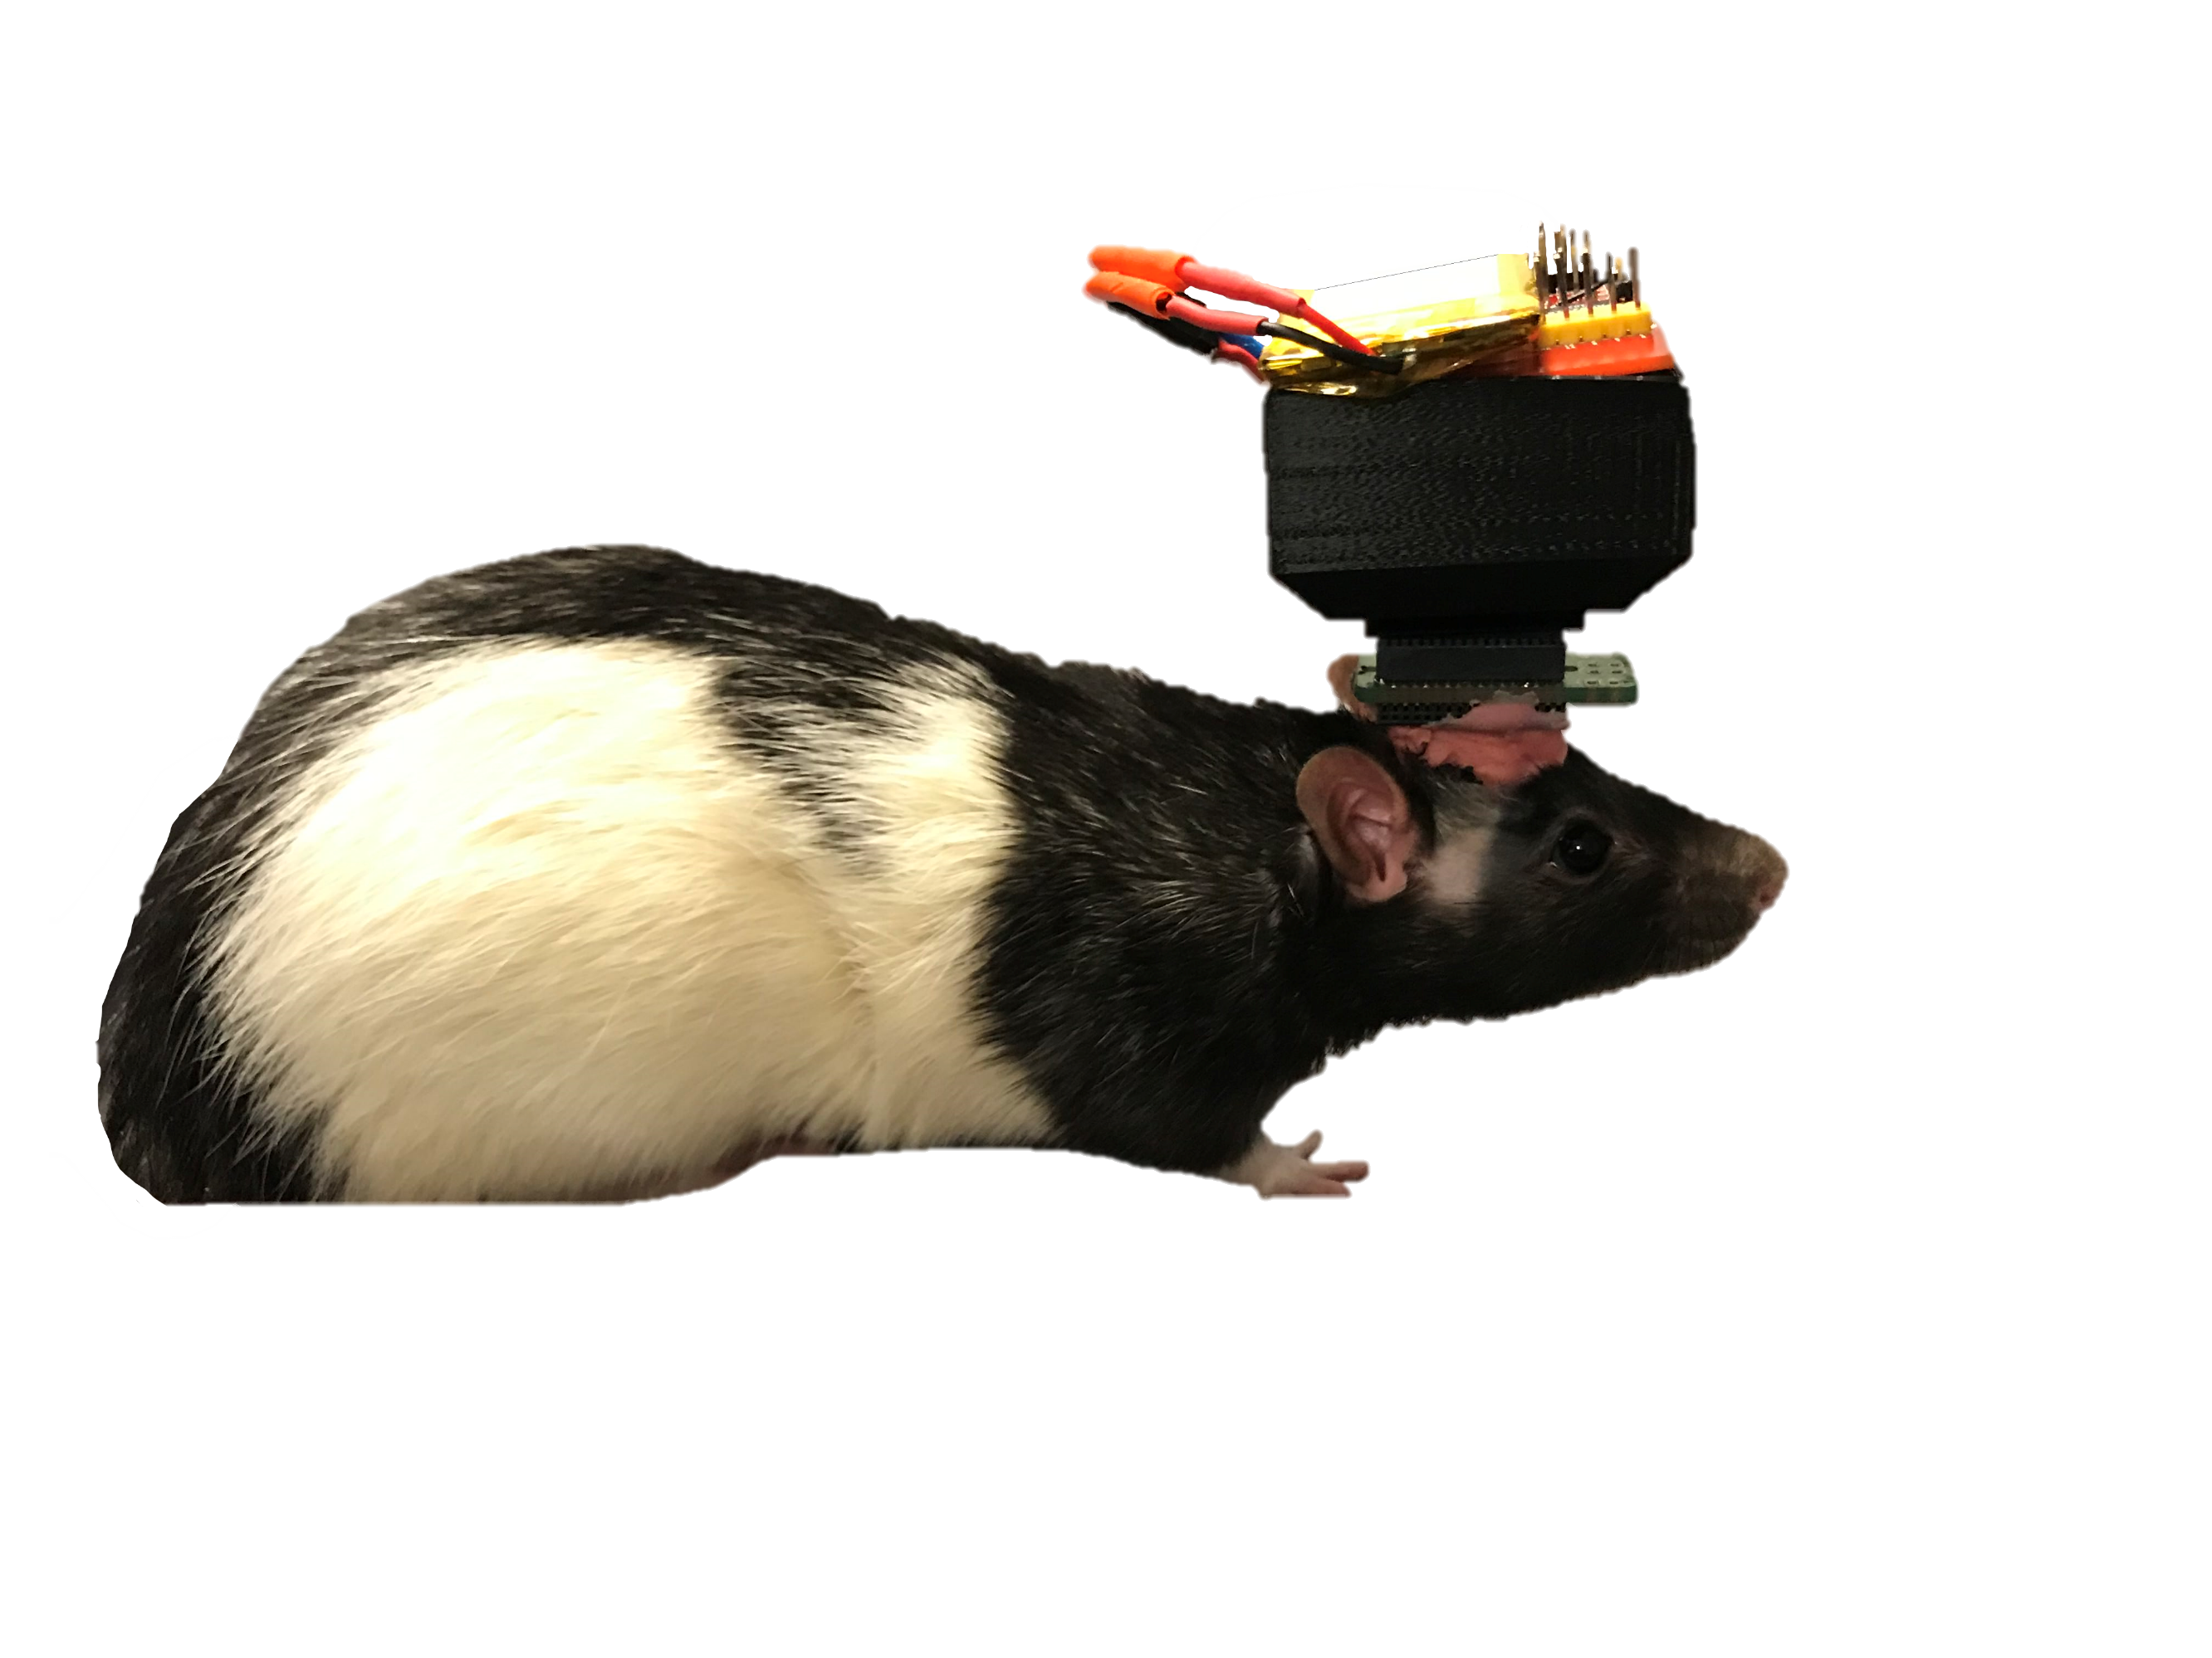

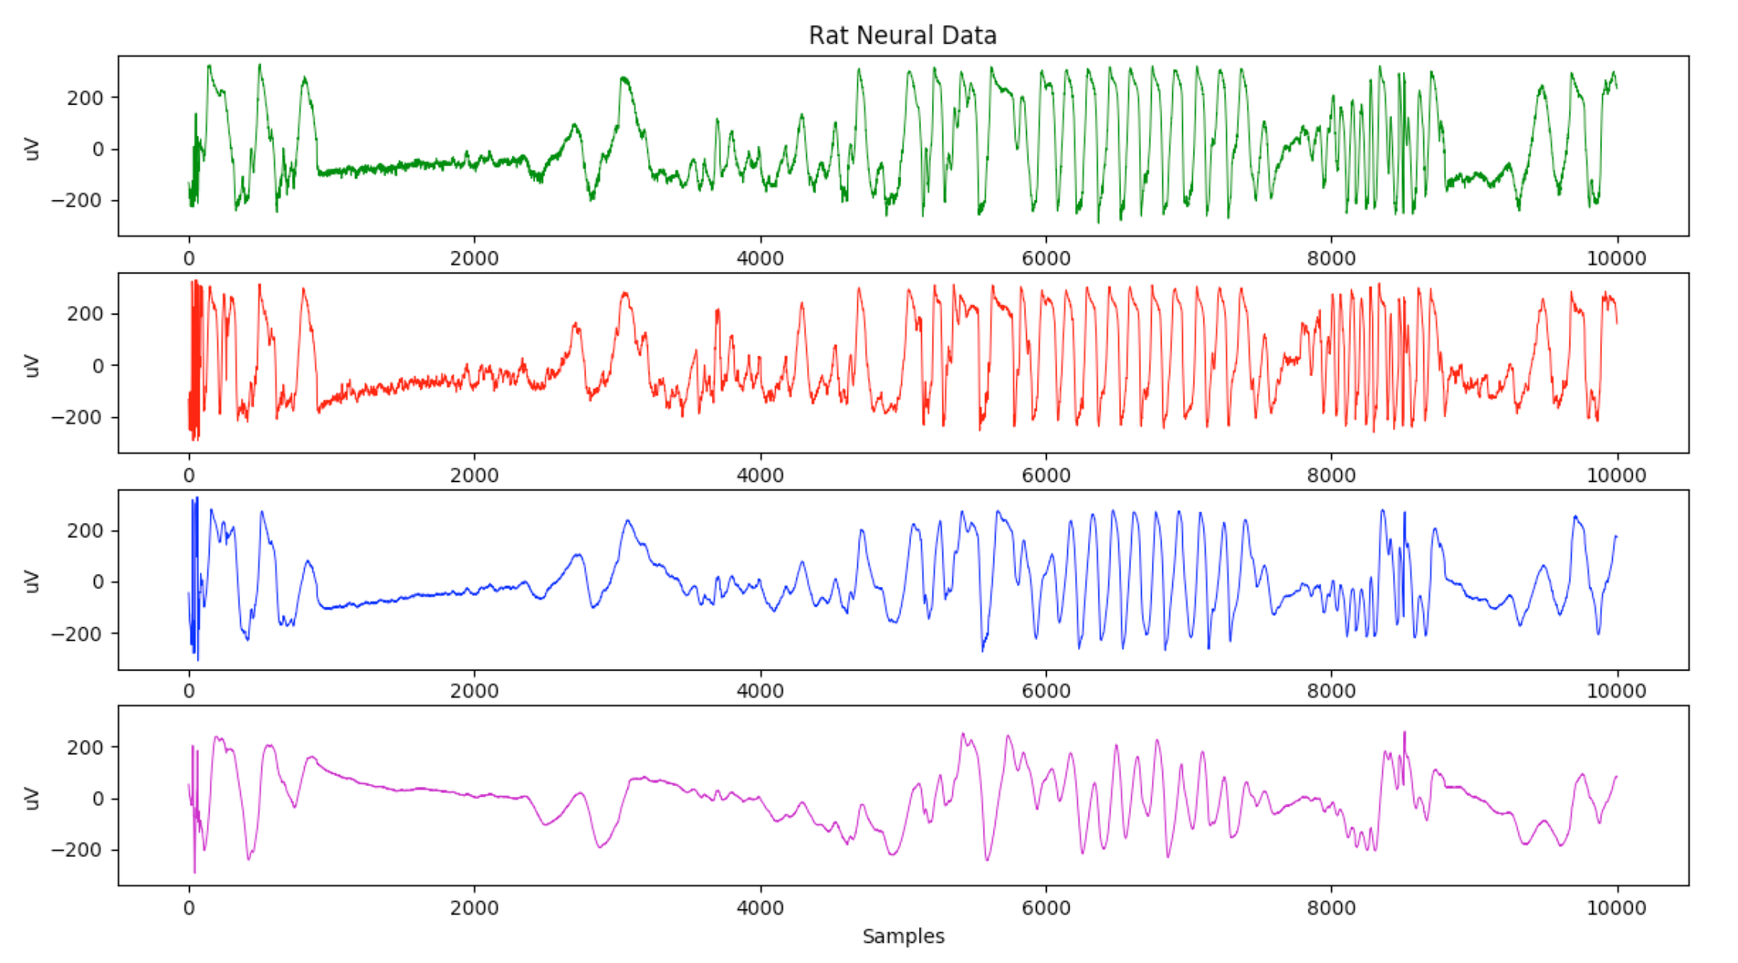
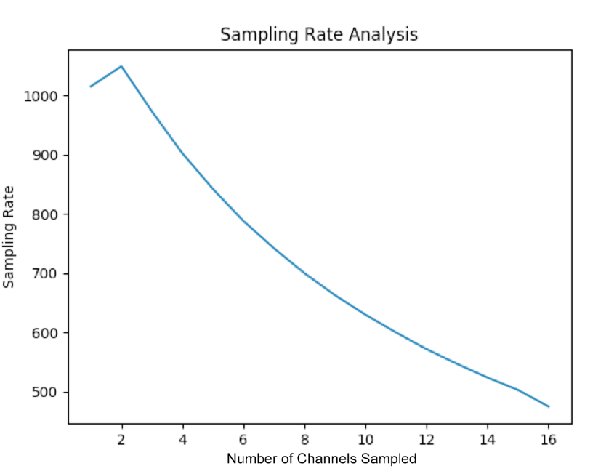
Wireless Recorder for Neural Implantation
Aidan Curtis, Sophia D’Amico, Andres Gomez, Benjamin Klimko, Zhiyang Zhang
riceaxonmobile@gmail.com
Motivation
Prototype Design
Screen Shot 2019-03-26 at 11.37.35 PM
30% of epilepsy patients do not respond to medicine or treatment [1]
These patients treated with neural implants to localize source of seizures
The most common recording system is tethered
Issues include hospital costs, possible infections, and inability to move on one’s own
Board Design
4x4 centimeters, 4 layers
Rests on top of scalp
Connects to electrode interface
board (EIB) implanted in a rat
(1) Wireless chip
(2) Digital interface chip to
collect neural data
(3) Transmission line
(4) Electrode test pins
(5) Integrated inverted F
antenna
1
Compression
Two types of neural data:
- Local field potentials (LFP)
- Action potentials/spikes (AP)
Predictive modeling used for LFP data
- Reduces signal entropy, which
reduces overall signal size
- Can achieve x2 compression
Novel compressive sensing algorithm used for AP data
- Exploits underlying signal sparsity
- Can achieve x12 compression
2
3
Design Specifications
PROBLEM: Tethered neural recording system hampers patients’ well-being
SOLUTION: A scalable wireless recorder that transmits neural data from implanted electrodes to an external receiver
4
5
Objective | Target | Progress
Multi-channel | 16-channel | 16-channel
Battery life | 24 hours | ~20 hours
Resolution | 8-bit ADC | 16-bit ADC
Wireless | ≥ 1m | 15m
Sampling Rate | ≥ 1kHz | 480Hz ~ 1kHz
Novelty | Compression algorithm | x2 LFP x12 AP
Wireless
CC2652 multi-protocol chip
2.4GHz Proprietary RF for data transmission
Transmission range of 15m
Adjustable sampling rate from 480Hz – 1kHz
Throughput of 120kBps
CC2652 RF receiver passes data to computer via UART
Sample Text
Rodent Implementation & Results
Don’t know what to put here???? –tested in rats, it was successful, we collected 6 channels of data, 4 are shown, we can collect 16 but did not have the space for it
Recap of specs + explain sampling rate vs. num channels tradeoff – could do the specs check marks here?
Future Work
Implement predictive modeling on wireless chip
Integrate full system with power peripherals
Implement a fuel gauge for monitoring power usage
include animal testing statements + Caleb and Ziying shoutouts (can go in below box)
Acknowledgements / References
This work was supported by funding from the OEDK and sponsorship from Altium. We give special thanks to Dr. Nitin Tandon of UT Health for inspiration and guidance, Dr. Caleb Kemere and his lab, RNEL, for assisting us in our rodent experimentation, and Dr. Gary Woods for guidance and technical assistance.
[1] World Health Organization, “Epilepsy,” www.who.int, Feb. 7, 2019. [Online]. Available: https://www.who.int/news-room/fact-sheets/detail/epilepsy. [Accessed: Feb. 20, 2019].

